Slide 1


Slide 2


Slide 3

BECOMING A LEADER
What to do when everyone looks to you

Slide 4
CONGRATULATIONS!
People are starting to look to you for advice, guidance and dare I say it, leadership.
But after you pop the champagne, raise a glass and step into the next chapter, the truth hits you: you have no clue what to do next…

Slide 5
1
Leaders are not born, they are made
2
They go through a crucible of challenges or leader points that shape them

Slide 6
README.md
(or the about me part of this thing)

Slide 7
Story Time

Slide 8
At some point, everyone will face a leader point.
That point in time where everyone looks to you

Slide 9
Definition: Leader point
A moment in time where individuals are looking or open to guidance
An opportunity to align people to a purpose
A chance to multiple the results of a team

Slide 10
1
2
3
IDENTIFY
PLAN
EXECUTE

Slide 11
1
2
3
IDENTIFY
PLAN
EXECUTE

Slide 12
What is a Leader?
What are Leader Points?
What Types of Leaders are there?

Slide 13
Definition of Leader
something that leads
a person who leads: such as
GUIDE, CONDUCTOR, The tour leader recommended several restaurants in the area.
a person who directs a military force or unit leaders of the army
a person who has commanding authority or influence a leader in the reform movement
the principal officer of a British political party
a party member chosen to manage party activities in a legislative bodythe majority leader
such a party member presiding over the whole legislative body when the party constitutes a majority the leader of the House
CONDUCTOR sense the orchestra's leader
a first or principal performer of a group. The concertmaster is the leader of the violin section.
a horse placed in advance of the other horses of a team

Slide 14
Simple definition of a Leader:
A leader is someone who guides the purpose, people, and process
Notes:
Across all levels these three things are always there. The importance of each changes at the different levels.

Slide 15
Leader /= Manager
They can overlap but are not mutually exclusive

Slide 16
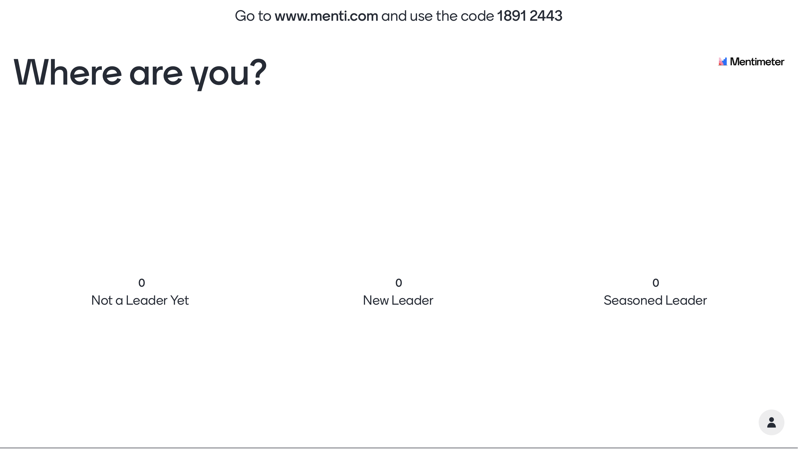

Slide 17
Purpose
How clearly a vision is communicated so that people can rally around it
People
Being able to identify when the right people are in the right positions
Process
Building a framework to enable the people to execute and get out of the way

Slide 18
Definition: Leader point
A moment in time where individuals are looking or open to guidance
An opportunity to align people to a purpose
A chance to multiple the results of a team
A leader point is the moment of change that happens where you can choose to lead or choose to let it pass you by. Some will be obvious, and some will not be obvious

Slide 19
Common signs of a leader point
That gut feeling where you “know” what should happen next, but no one else sees it
When you are the most experienced or longest tenure
At the start of a project when direction is need
When a project is going off the rails
When things have reached a point of diminishing returns

Slide 20
Different stages of leadership
Have different leader points

Slide 21
Early leader points
When team members come to you for advice
When in a group round table or planning where there is silence, people looking around
When a team needs to present an idea publicly
Usually focused on the “process”

Slide 22
Mid leader points
Tend to come up in cross functional meetings or interactions
More visible and more obvious
Begin to focus more on the people with the process
Align to a larger purpose and distill it for the team

Slide 23
Senior leader points
More ambiguous, making decisions with less detail. More high-level direction
Setting the direction for multiple teams or products
Purpose is the key focus area
Creating a loose process that enables freedom for the people

Slide 24
1
2
3
IDENTIFY
PLAN
EXECUTE

Slide 25
Leadership is like anything else
The more you practice the easier it gets

Slide 26
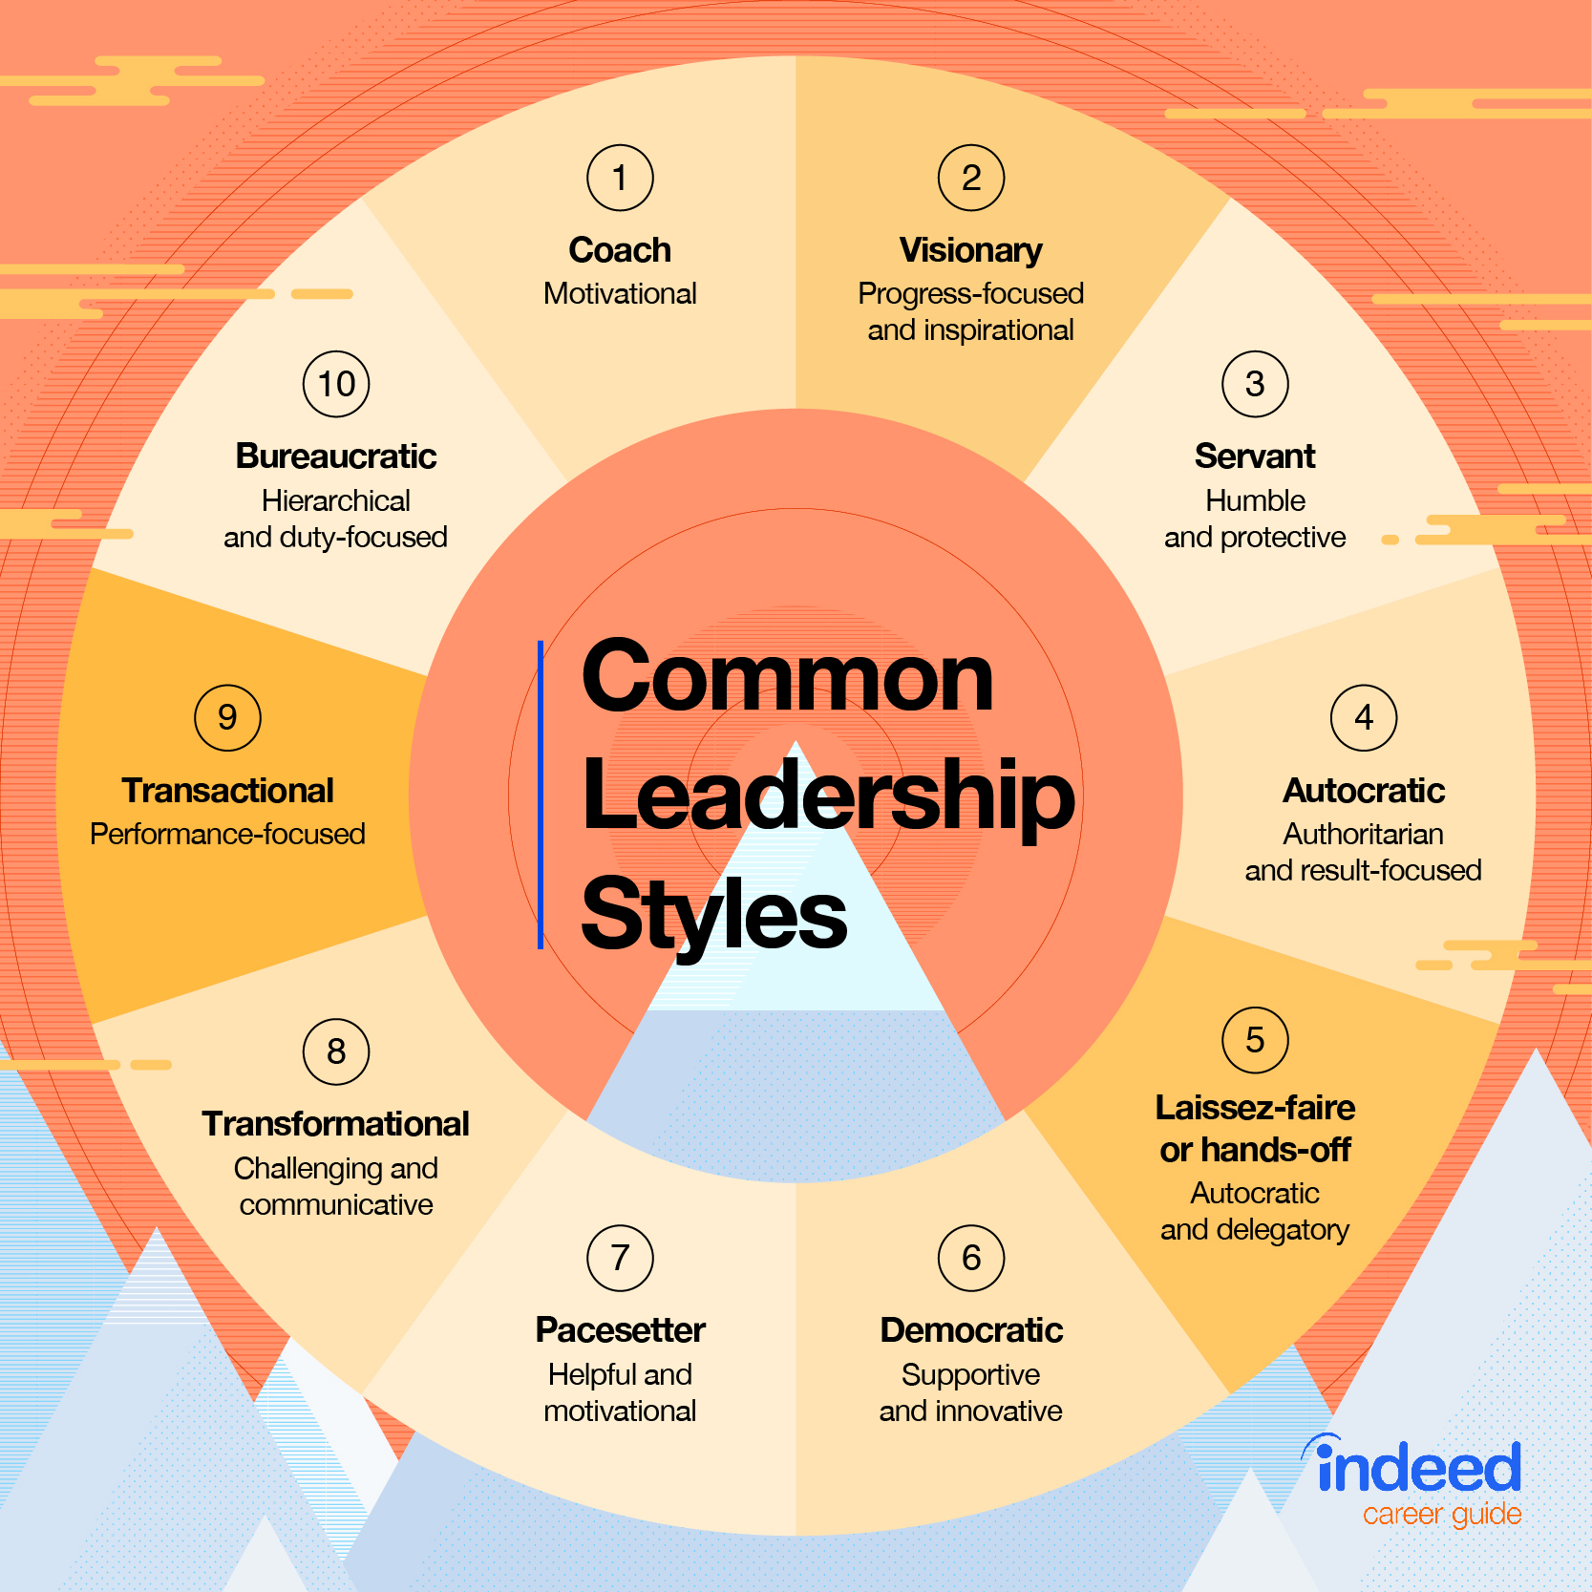

Slide 27
Let’s talk about 5 styles
COACH
VISIONARY
SERVANT
AUTOCRATIC
DEMOCRATIC
https://www.indeed.com/career-advice/career-development/10-common-leadership-styles

Slide 28
COACH
VISIONARY
SERVANT
AUTOCRATIC
DEMOCRATIC
A coaching leader is someone who can quickly recognize their team members’ strengths, weaknesses and motivations to help each individual improve.
This type of leader often assists team members in setting smart goals and then provides regular feedback with challenging projects to promote growth.

Slide 29
COACH
VISIONARY
SERVANT
AUTOCRATIC
DEMOCRATIC
Visionary leaders have a powerful ability to drive progress and usher in periods of change by inspiring employees and earning trust for new ideas.
A visionary leader is also able to establish a strong organizational bond. They strive to foster confidence among direct reports and colleagues alike.

Slide 30
COACH
VISIONARY
SERVANT
AUTOCRATIC
DEMOCRATIC
Servant leaders live by a people-first mindset and believe that when team members feel personally and professionally fulfilled, they’re more effective and more likely to regularly produce great work.
Because of their emphasis on employee satisfaction and collaboration, they tend to achieve higher levels of respect.

Slide 31
COACH
VISIONARY
SERVANT
AUTOCRATIC
DEMOCRATIC
Also called the “authoritarian style of leadership,” this type of leader is someone who is focused primarily on results and efficiency.
They often make decisions alone or with a small, trusted group and expect employees to do exactly what they’re asked. It can be helpful to think of these types of leaders as military commanders.

Slide 32
COACH
VISIONARY
SERVANT
AUTOCRATIC
DEMOCRATIC
A democratic leader is someone who asks for input and considers feedback from their team before making a decision.
Because team members feel their voice is heard and their contributions matter, a democratic leadership style is often credited with fostering higher levels of employee engagement and workplace satisfaction.

Slide 33
Questions to ask yourself?
What do I value more—goals or relationships?
Do I believe in structure or freedom of choice?
Would I rather make a decision on my own, or collectively?
Do I focus on short or long-term goals?
Does motivation come from empowerment or direction?
What does a healthy team dynamic look like to me?

Slide 34
What situations are you seeing?
How will you practice?

Slide 35
1
2
3
IDENTIFY
PLAN
EXECUTE

Slide 36
There are ways to develop leadership
https://www.wrike.com/blog/9-ways-develop-leadership-skills/

Slide 37
Be a discerning listener
Practice Discipline
Take on new challenges
Learn to follow
Develop situational awareness
Inspire others
Empower your teammates
Keep learning
https://www.wrike.com/blog/9-ways-develop-leadership-skills/

Slide 38
Be a discerning listener
Practice Discipline
Take on new challenges
Learn to follow
Develop situational awareness
Inspire others
Empower your teammates
Keep learning
https://www.wrike.com/blog/9-ways-develop-leadership-skills/

Slide 39

Be a discerning listener
Becoming a leader doesn't mean you always have to be in the spotlight. An important trait of a good leader is someone who listens to suggestions, ideas, and feedback from other people, and build on them. Good listeners know that communication is not only about words, but picking up on non-verbal cues, such as eye contact and body language.

Slide 40
Practice discipline
A good leader needs discipline. Developing discipline in your professional (and personal) life is a must in order to be an effective leader, and to inspire others to be disciplined as well. People will judge your capacity to lead by the amount of discipline you display at work.
https://www.wrike.com/blog/9-ways-develop-leadership-skills/

Slide 41

Take on new challenges
A great way to develop your leadership skills is to take on more responsibility. You don't have to take on more than you can handle, but you do need to do more than simply what's covered in your job description if you want to grow. Stepping out of your comfort zone is the only way you will learn anything new, and doing so will get you noticed by executives as someone who takes initiative.

Slide 42
Learn to follow
A true leader has no problem yielding control to another person when appropriate. You should not feel threatened when someone disagrees with you, questions your thinking, or puts forth ideas of their own. Keep an open mind and give merit where merit is due. It won't always be easy, but if you learn to value and respect others on your team, they'll be more likely to step up to the plate for you.
https://www.wrike.com/blog/9-ways-develop-leadership-skills/

Slide 43

Develop Situational Awareness
A mark of a good leader is someone who can see the bigger picture, and anticipate problems before they occur. This is a valuable skill to have when handling complex projects with tight deadlines. The ability to foresee and provide suggestions for avoiding potential problems is invaluable for a leader. This ability also helps you recognize opportunities that others overlook, which will certainly earn you recognition.

Slide 44
Inspire others
Being a leader means you are part of a team, and as a leader you should be able to motivate and inspire those you work with to collaborate as best they can. When a team member needs encouragement or guidance, offer it. Sometimes, all a person needs is someone to listen and be sympathetic.
https://www.wrike.com/blog/9-ways-develop-leadership-skills/

Slide 45

Empower your teammates
No one is the best at everything, and the sooner you realize that, the sooner you can learn to be a good leader. Delegating tasks to others not only frees you up for things you do well, it also empowers other people on your team.

Slide 46
Keep learning
The best path to becoming a good leader is to always keep learning new things. It keeps your mind sharp, and your skills fresh. It primes you for new challenges that may come your way, which is always a good thing in a leader
https://www.wrike.com/blog/9-ways-develop-leadership-skills/

Slide 47
Be personal
Be confident
Be learning
Notes:
Practical tips
Be personal (relatable)
Build trust by caring about your teammates
Be confident
If you don’t trust yourself, why should others?
Challenge yourself to keep learning
Set a goal, even a small one

Slide 48
PUT IT INTO PRACTICE
Identify > What are the leader points facing you?
Plan > What style or actions can you take?
Execute > When will you take action?

Slide 49
End Story Time

Slide 50
DO NOT
WAIT FOR
LEADERS
BECOME
THEM.

Slide 51



{FURTHER READING}

Slide 52





QUESTIONS?
@iamkeeler
(612) 486-2096
https://github.com/iamkeeler/THAT-Conference/

Slide 53


